Slide 1
The Field of Data Science
Data Analysis
Shahriar’s Analytical Academy

Slide 2
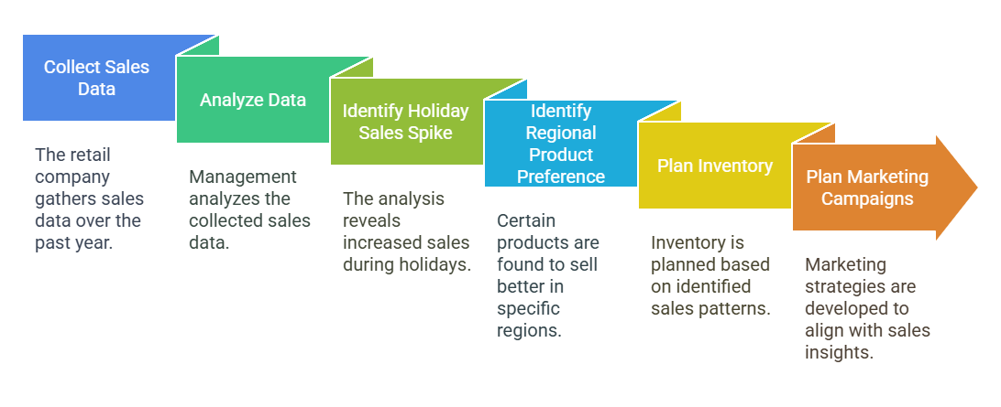
Definition and Example
Data analysis refers to the process of inspecting, cleaning, transforming, and modeling data to discover useful information, draw conclusions, and support decision-making. It involves interpreting data in meaningful ways to identify patterns, trends, or correlations.
Notes:
Data analysis is a process where we examine and organize data to find useful information. This process helps us make better decisions by understanding patterns or trends within the data. It involves several steps like cleaning the data to remove mistakes, transforming it into a more usable format, and then looking for relationships or trends. By doing this, we can gain insights that help businesses or individuals make informed choices.
Example Scenario: Let’s imagine a retail company that collects sales data over the past year. The company wants to understand how customers are buying products so they can improve their marketing efforts. By analyzing the data, they find that during the holiday season, their sales numbers increase significantly. Also, they notice that certain products are more popular in specific regions, like winter coats selling better in colder areas. With this information, the company can plan ahead by stocking up on the right products in the right locations and running targeted marketing campaigns during peak seasons. This helps the company increase sales and satisfy customer needs more effectively.

Slide 3
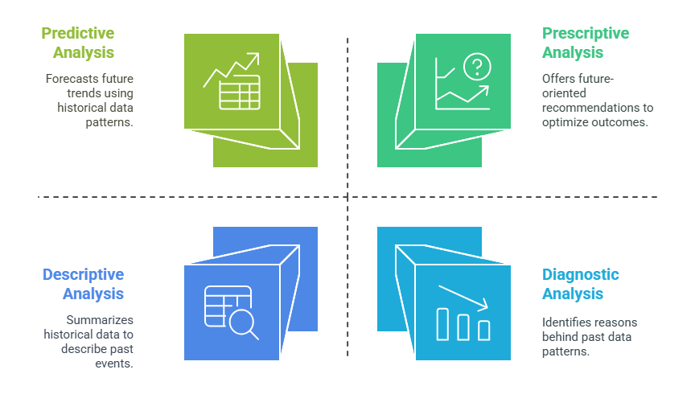
Types of Data Analysis
Notes:
Descriptive Analysis: Descriptive analysis is about looking at past data to understand what has happened. It helps summarize and explain historical trends or behaviors. For example, if a company wants to know the average sales for a month or the typical age range of its customers, descriptive analysis can help by providing these basic statistics. It's like looking back at the records to get a clearer picture of what occurred in the past.
Diagnostic Analysis: Diagnostic analysis goes a step further by trying to figure out why something happened. It helps to identify patterns or relationships in the data that might explain certain outcomes. For instance, if sales dropped in a particular quarter, diagnostic analysis would dig into the data to find out the reason behind the decline. It could uncover factors like a product shortage, a competitor’s promotion, or a shift in customer preferences that led to the drop.
Predictive Analysis: Predictive analysis uses past data to forecast what might happen in the future. By examining historical trends, it helps businesses predict future behaviors, trends, or outcomes. For example, a company might look at the sales data from previous years to predict how much they are likely to sell next quarter. This helps businesses plan ahead and make informed decisions about inventory, staffing, or marketing.
Prescriptive Analysis: Prescriptive analysis not only predicts what might happen in the future but also suggests actions to optimize outcomes. It provides recommendations based on the data to help businesses make the best choices. For example, if a company wants to increase sales in the next quarter, prescriptive analysis might suggest strategies like offering discounts, running a targeted social media campaign, or improving customer service. This analysis provides actionable insights to improve performance.

Slide 4
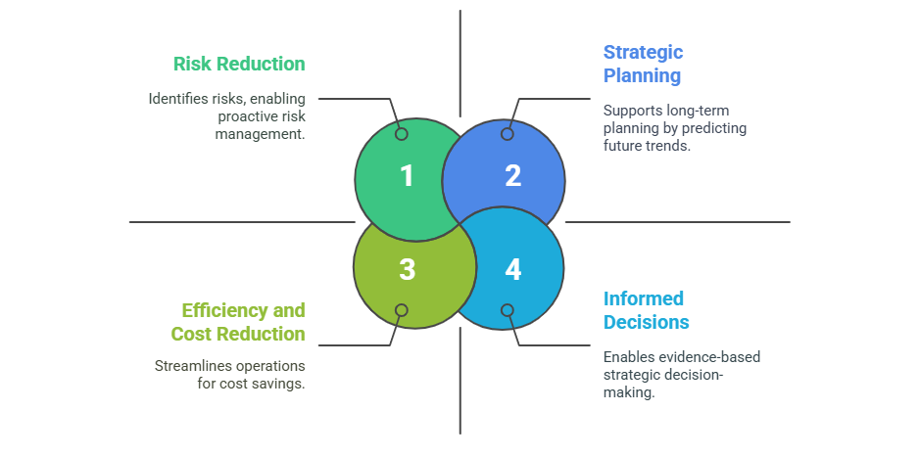
Importance of
Data Analysis
Notes:
Informed Decisions: Data analysis helps decision-makers base their choices on facts and evidence instead of relying on guesses or gut feelings. By using data, leaders can understand the real situation and make well-informed decisions. For example, if a marketing manager notices that a particular advertisement has shown the best return on investment (ROI) through data analysis, they can confidently decide to increase the budget for that ad. This ensures that their decision is backed by real performance, not just assumptions.
Risk Reduction: Data analysis is a powerful tool in identifying potential risks before they become a problem. By analyzing trends and patterns, businesses can spot issues early and take preventive actions. For example, a bank can use data analysis to monitor transactions and detect suspicious activity, allowing them to prevent fraudulent transactions before they happen. This helps avoid losses and protects the company from unnecessary risks.
Efficiency and Cost Reduction: Data analysis can help businesses improve their operations, making them more efficient and saving costs. By looking at the data, businesses can identify areas where they can cut expenses and streamline processes. For instance, a manufacturer can analyze inventory data to figure out how much stock they need to keep and avoid overstocking, which saves on storage costs. This makes the business run more smoothly and saves money.
Strategic Planning: Data analysis is crucial for long-term planning, as it allows businesses to predict future trends and customer behaviors. By understanding these patterns, companies can make strategic decisions to position themselves for success in the future. For example, data analysis could reveal that a certain product category is growing in demand, helping a company plan to invest in that area to meet future customer needs. This ensures that businesses are not only reacting to current trends but are also prepared for what lies ahead.

Slide 5
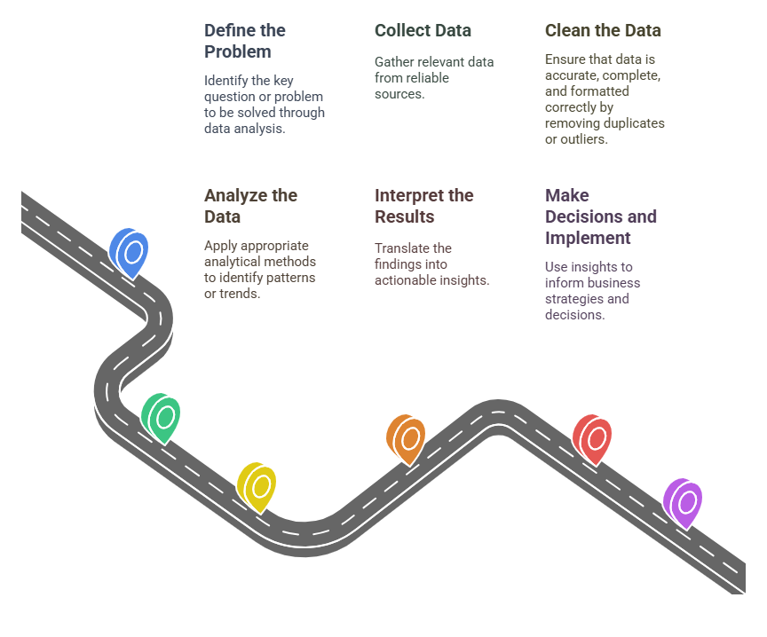
Steps in Data Analysis
Notes:
Define the Problem: The first step in analyzing data is to clearly define the problem or question that needs to be answered. This helps focus the entire analysis process on finding relevant solutions. For example, a business may want to know what factors affect customer satisfaction. By identifying this question, the company sets the direction for what data to collect and analyze.
Collect Data: Once the problem is defined, the next step is to gather the necessary data. This involves sourcing relevant information from reliable and trustworthy places. For instance, a company may collect survey data, customer feedback, or sales history to get insights into customer preferences. It’s important to make sure the data gathered is relevant to the problem at hand.
Clean the Data: Before analyzing, it's important to clean the data to ensure it is accurate and consistent. This means checking for errors, removing duplicate records, or eliminating outliers that could skew results. For example, if some customer survey responses are incomplete or incorrectly filled out, these records would need to be removed to avoid impacting the analysis.
Analyze the Data: With clean data in hand, the next step is to analyze it using appropriate methods. This could involve applying statistical techniques or tools to find patterns or trends that address the problem. For example, using regression analysis to examine how different variables, such as product quality or customer service, affect customer satisfaction can provide valuable insights into what influences the overall experience.
Interpret the Results: Once the data is analyzed, the findings need to be interpreted in a way that provides clear insights. This step involves making sense of the numbers and understanding what they mean in real-world terms. For example, if the analysis reveals that complaints about product features are linked to customer dissatisfaction, the business now knows where to focus their improvements.
Make Decisions and Implement: Finally, the insights gathered from the data analysis should guide business decisions. This could involve making strategic changes based on the findings. For example, the business might decide to improve certain product features that were causing dissatisfaction among customers. These decisions can then be implemented to improve performance or outcomes moving forward.

Slide 6
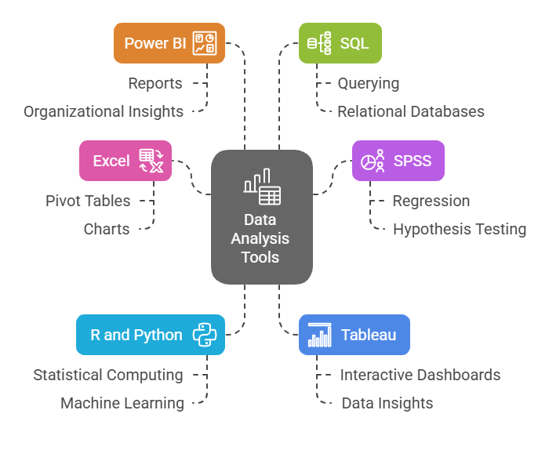
Tools of
Data Analysis
Notes:
Excel: Excel is one of the most commonly used tools for data analysis, especially when working with smaller datasets. It offers a range of built-in features like Pivot Tables, charts, and formulas that allow users to organize, analyze, and visualize data easily. For example, Excel can help you calculate averages, create bar charts to compare data, or summarize large amounts of information using Pivot Tables, making it a great tool for everyday analysis tasks.
SPSS: SPSS (Statistical Package for the Social Sciences) is a powerful software tool used mainly in the social sciences for more complex data analysis. It allows researchers to perform various statistical tests, such as regression analysis and hypothesis testing, to understand the relationships between different variables. SPSS is commonly used in academic research and studies where detailed statistical analysis is required to draw conclusions.
R and Python: R and Python are programming languages widely used in data science and analytics. They are excellent for performing advanced statistical computing, data manipulation, and machine learning tasks. R is particularly popular for statistical analysis and data visualization, while Python is versatile and supports a wide range of libraries and frameworks (like Pandas, NumPy, and Scikit-learn) for data analysis, machine learning, and deep learning. Both are powerful tools for handling large datasets and conducting complex analyses.
Tableau: Tableau is a data visualization tool that helps present data in an interactive and visually appealing way. It allows users to create dynamic dashboards and visualizations to better understand data trends and insights. With Tableau, you can quickly turn complex data into understandable charts, graphs, and interactive reports, making it easier for stakeholders to analyze and make decisions based on the data.
Power BI: Power BI is another powerful data visualization and business analytics tool from Microsoft. It is used to create reports and dashboards that help organizations analyze data and share insights across teams. Power BI is particularly useful for connecting to various data sources, transforming that data, and then creating interactive reports that provide real-time business intelligence, allowing organizations to track performance and make informed decisions.
SQL: SQL (Structured Query Language) is used to manage and query large datasets stored in relational databases. It helps users retrieve specific data from databases by writing queries to filter, sort, and analyze the information. SQL is especially useful when working with large volumes of data and is essential for handling tasks such as data extraction, data transformation, and data management within an organization’s database system.

Slide 7
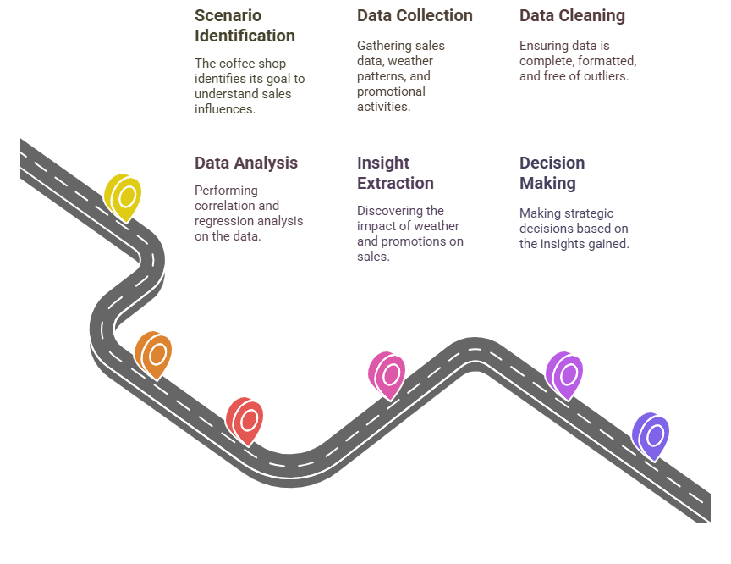
How to find insight with example scenario
Notes:
Imagine a coffee shop that wants to understand how different factors, such as weather, time of day, and promotions, influence its sales. By analyzing data, the coffee shop can identify patterns that will help them optimize their business decisions.
Step 1: Data Collection The first step is to gather relevant data. The coffee shop collects sales data for the past year, along with information on weather patterns (like temperature), the time of day, and any promotional activity (like discounts or special offers). This data will help analyze the factors that could affect sales.
Step 2: Data Cleaning Once the data is collected, it’s important to clean it. This means removing any missing or incomplete data points, ensuring that all variables are in the same format (e.g., temperature in Celsius, time in hours), and addressing any outliers (such as unusually high sales due to a special event) that could distort the analysis.
Step 3: Data Analysis Now, the coffee shop can start analyzing the data. They might use correlation analysis to examine how weather, for example, affects sales. For instance, they might find that colder days correlate with higher sales of hot beverages. Additionally, they could use regression analysis to predict future sales based on weather and time of day. This helps identify which factors are most important for driving sales.
Step 4: Insight Extraction After analyzing the data, the coffee shop discovers valuable insights. They find that hot beverage sales increase by 25% on colder days, and promotions lead to a 30% boost in sales. These insights are key to understanding how various factors influence customer behavior.
Step 5: Decision Finally, the coffee shop can use these insights to make informed decisions. For example, based on the finding that promotions drive higher sales, they could plan special offers during colder weather to boost sales. Additionally, knowing that certain times of day are busier than others, they can adjust staffing levels during peak hours to ensure they meet customer demand efficiently.

Slide 8
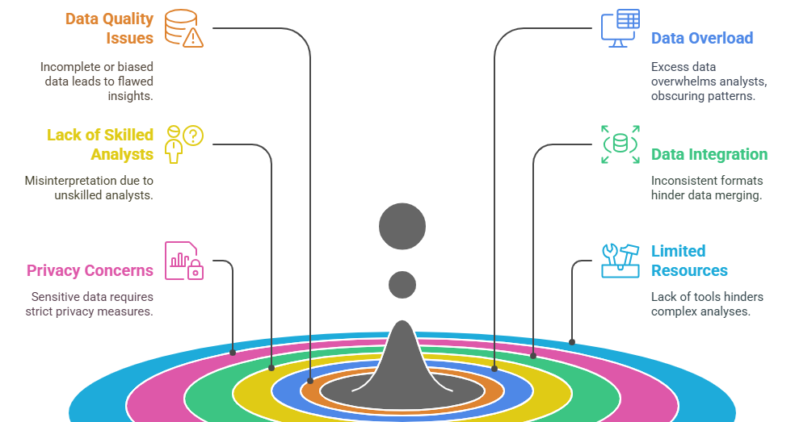
Challenges in Data Analysis
Notes:
Data Quality Issues: One of the most common challenges in data analysis is dealing with poor-quality data. If the data is incomplete, inaccurate, or biased, it can lead to incorrect conclusions and misleading insights. For example, if customer feedback surveys are missing responses or contain errors, any analysis based on that data will be unreliable. Ensuring data quality is crucial for obtaining accurate and trustworthy results.
Data Overload: Another challenge is the overwhelming amount of data that analysts sometimes face. With so much information available, it can become difficult to identify the most relevant data or find meaningful patterns. This situation, known as "data overload," can slow down the analysis process and lead to important insights being overlooked. To manage this, it's essential to focus on key data points that directly address the problem at hand.
Lack of Skilled Analysts: Data analysis requires specific skills, such as knowledge of statistical methods, programming, and analytical tools. Without skilled analysts, data analysis can be poorly executed or misinterpreted. For example, a novice might draw incorrect conclusions from data or fail to apply the right analytical techniques. It's important for organizations to invest in training or hire professionals who have the expertise to perform accurate analysis.
Data Integration: When data is collected from various sources, such as sales records, customer service logs, and marketing campaigns, it can be challenging to combine all of it into a single, cohesive dataset. Different sources may have inconsistencies in formats, terminology, or structure, making it difficult to merge the data accurately. Proper data integration requires careful attention to detail and sometimes advanced tools to ensure all data fits together correctly.
Privacy Concerns: Especially in sectors like healthcare or finance, handling sensitive data must be done with great care. Privacy concerns are a major challenge because data breaches or unethical use of personal information can lead to severe consequences. Organizations must ensure they comply with privacy laws and ethical standards when collecting, storing, and analyzing data to protect individuals' rights and maintain trust.
Limited Tools or Resources: Not all organizations have access to advanced tools or resources needed for sophisticated data analysis. Smaller companies, for instance, may lack the budget to purchase high-end software like SPSS, Tableau, or Power BI. This limitation can hinder their ability to perform complex analyses and gain deeper insights. Organizations without these resources may need to rely on more basic tools like Excel or free open-source software to work with their data.

Slide 9
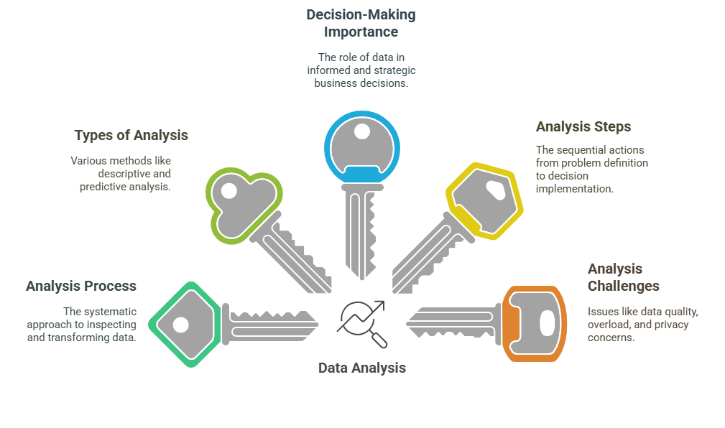
5 Key Learning Points of this Lesson
Notes:
In this lesson, you have learnt about the Data Analysis Process, which involves inspecting, cleaning, and transforming data to uncover insights that support decision-making. The process helps in turning raw data into valuable information that can guide business strategies.
They will also explore the Types of Data Analysis, including descriptive, diagnostic, predictive, and prescriptive analysis. Each type serves a unique purpose, such as summarizing past events, identifying causes, forecasting future trends, and recommending actions to improve outcomes.
Students will understand the Importance of Data Analysis in Decision Making, as it enables businesses to make informed decisions, reduce risks, improve efficiency, and plan for the future. Data-driven decisions are crucial for staying competitive and adapting to market changes.
The Steps in Data Analysis will be covered, from defining the problem and collecting data to cleaning, analyzing, and implementing decisions. These steps guide students through a structured approach to solving problems with data.
Finally, students will learn about the Challenges in Data Analysis, such as data quality issues, data overload, lack of skilled analysts, and privacy concerns. Understanding these challenges is essential for effectively managing and analyzing data in real-world scenarios.

Slide 10
Thank You!
Shahriar’s Analytical Academy

